Slide 1


Diogo Gonçalves Silva
26/05/2025

Slide 2

Outline
Executive Summary
Introduction
Methodology
Results
Conclusion
Appendix

Slide 3
Executive Summary
Summary of methodologies
Data Collection
Data Wrangling
EDA with data visualization
EDA with SQL
Interactive map with Folium
Dashboard with Plotly Dash
Predictive analysis
Summary of all results
Exploratory data analysis result
Interactive analytics demo w/ screenshots
Predictive analysis results

Slide 4
Introduction
Project background and context
SpaceX’s Falcon 9 rocket reduces launch costs by reusing its first stage, saving up to $103 million per launch compared to other providers. Predicting the success of these landings is key to determining launch costs and helping competitors in the space launch industry.
Problems you want to find answers
What influences the success of a landing.
The relations between the rocket variables and the rate of successful landings.

Slide 5

Section 1

Slide 6
Methodology
Executive Summary
Data collection methodology:
Space X Rest API and Webscraping from wikipedia
Perform data wrangling
One hot encoding data for ML and drop of irrelevant columns
Perform exploratory data analysis (EDA) using visualization and SQL
Perform interactive visual analytics using Folium and Plotly Dash
Perform predictive analysis using classification models
How to build, tune, evaluate classification models

Slide 7
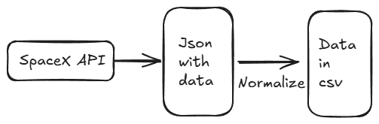
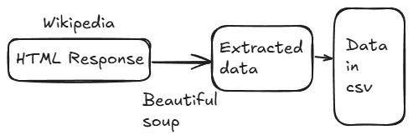
Data Collection
Describe how data sets were collected.
I gathered the data from the SpaceX REST API
The data includes rocket used, payload, specifications, landing sites, outcomes.

Slide 8
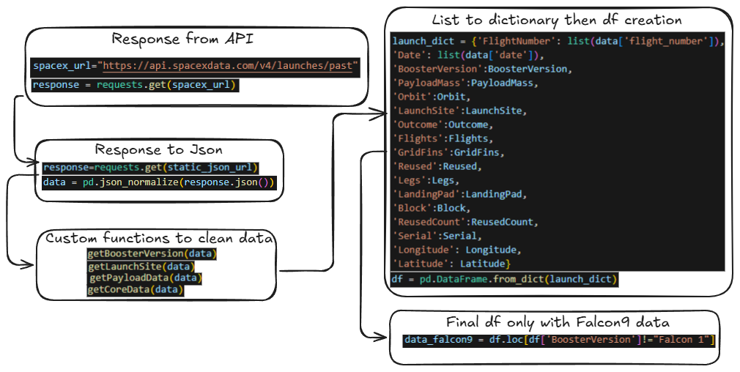
Data Collection – SpaceX API
Github Notebook URL

Slide 9
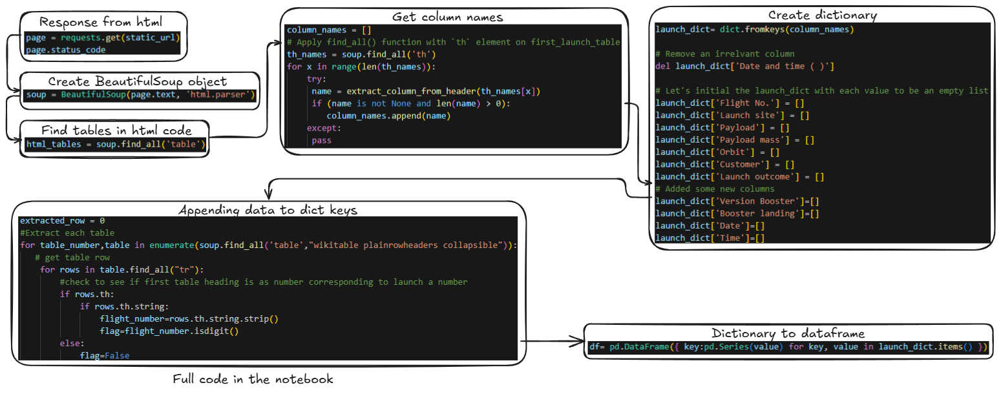
Data Collection - Scraping
Github Notebook URL

Slide 10
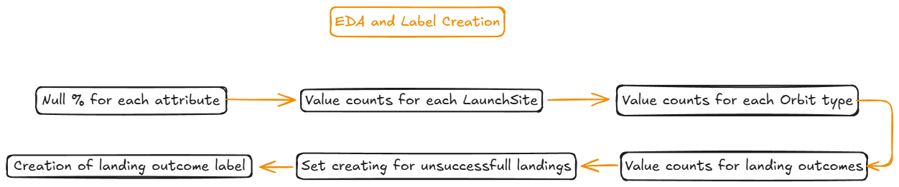
Data Wrangling
In this dataset, we observe multiple scenarios where booster landings either succeeded or failed. These outcomes are recorded in various formats—for instance, “True Ocean” indicates a successful landing in a designated ocean area, while “False Ocean” refers to an attempted ocean landing that failed. Similarly, “True RTLS” and “False RTLS” represent successful and failed landings on ground pads, and “True ASDS” and “False ASDS” denote outcomes on drone ships.As part of our data wrangling process, we’ll simplify these categories by transforming them into binary training labels: 1 for a successful landing, and 0 for an unsuccessful one. This step is crucial for preparing the data for future analysis and machine learning models.
Github Notebook URL

Slide 11
EDA with Data Visualization
Summary of Graphs – Falcon 9 EDA
Histograms and Density Plots Show the distribution of continuous variables like Payload Mass, Flight Number, and Orbit. Useful for detecting patterns, skewness, and possible outliers.
Boxplots Compare the distribution of Payload Mass across different orbit types and landing outcomes. Reveal variability and help identify extreme values.
Scatter Plots Illustrate the relationship between Payload Mass and Flight Number, distinguishing between successful and failed landings. Help assess the impact of experience and payload size on landing success.
Bar Charts Display the frequency of launches by Launch Site, Orbit, and Landing Outcome. Useful for comparing categories and evaluating overall mission performance.
Correlation Heatmap Visualizes correlations between numerical variables like Flight Number, Payload Mass, and Block. Highlights strong relationships that may inform predictive modeling.
Github Notebook URL

Slide 12
EDA with SQL
Created a new table that only includes missions with valid launch dates.
Listed all unique launch sites used by SpaceX.
Displayed sample missions launched from Cape Canaveral.
Calculated the total payload mass carried specifically for NASA (CRS) missions.
Found the average payload mass for missions using the “F9 v1.1” booster version.
Identified the first date a successful ground pad landing occurred.
Retrieved booster versions that landed successfully on a drone ship while carrying payloads between 4000 and 6000 kg.
Counted the number of missions grouped by outcome (e.g., success, failure).
Found which booster version was used for the mission with the heaviest payload.
Analyzed failed drone ship landings in 2015 by extracting the month, booster version, and launch site.
Github Notebook URL

Slide 13
Build an Interactive Map with Folium
To visualize the launch data into an interactive map, we took the coordinates of each launch site and added a circle marker around each launch site with a label naming it.
The landing outcomes class was market on the map with green/red to distinguish if a landing was successful or not.
Github Notebook URL

Slide 14
Build a Dashboard with Plotly Dash
First there’s a drop-down menu with the launch sites.
After that there’s a pie chart showing the successful launches from all sites.
It’s also possible to select a range of payloads with the range slider
For last, there’s an interactive scatter plot showing the correlation between payload mass and launch success that will change according to the option select from the drop-down menu.
With this interactive dashboard it’s possible to analyze the SpaceX launch data and gain insights into which factors contribute most to successful missions.
Github Notebook URL

Slide 15
Predictive Analysis (Classification)
Data Preparation
Loaded cleaned dataset from previous steps.
Applied one-hot encoding to categorical variables.
Train-Test Split
Divided data into training and test sets (80/20 split).
Ensured that the target was binary (0: fail, 1: success).
Model Building
Trained multiple classifiers:
Logistic Regression
Support Vector Machine (SVM)
Decision Tree
K-Nearest Neighbors (KNN)
Model Evaluation
Used accuracy, F1-score, and confusion matrix for evaluation.
Visualized model performance comparisons.
Model Tuning
Performed GridSearchCV to optimize hyperparameters for each model.
Selected best parameters based on cross-validation scores.
Model Selection
Compared tuned models and selected the best-performing one.
Final model used for prediction and deployed in the pipeline.
Github Notebook URL

Slide 16
Results
Exploratory data analysis results
Interactive analytics demo in screenshots
Predictive analysis results

Slide 17

Section 2

Slide 18
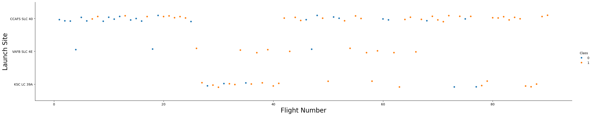
Flight Number vs. Launch Site
The higher number of flights tend to influence the overall sucess of a mission

Slide 19
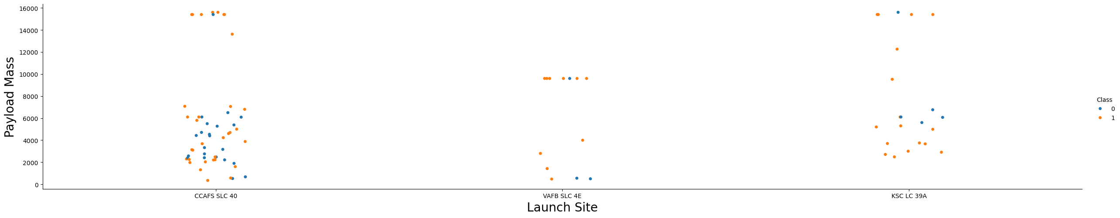
Payload vs. Launch Site
For CCAFS SLC 40, the missions with higher payload mass showed better results. There’s not enough statistical evidence to say that a certain launch site is a factor to determine if the mission will be sucessful or not.

Slide 20
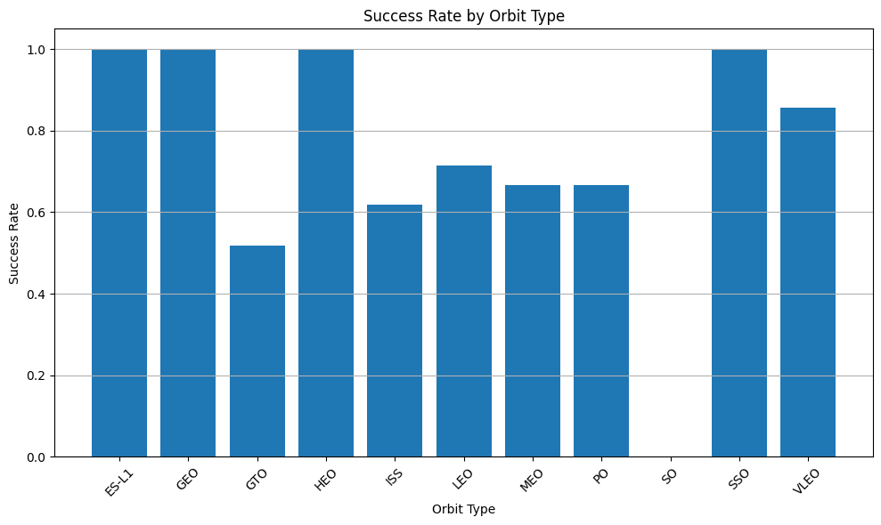
Success Rate vs. Orbit Type
Orbit ES-L1, GEO, HEO and SSO has the best sucess rate.

Slide 21
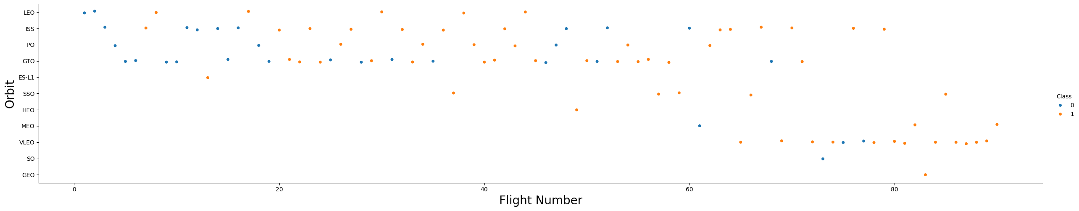
Flight Number vs. Orbit Type
From this chart it’s possible to see that LEO orbit shows better results with higher amount of flights.

Slide 22
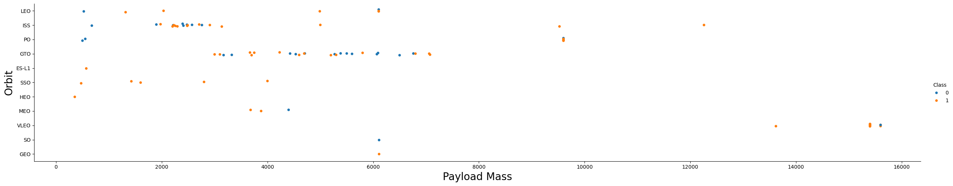
Payload vs. Orbit Type
For GTO orbit it’s possible to see that the higher payload afects negatively the sucess of a mission. For the other side, LEO, PO and ISS shows better results for higher payloads.

Slide 23
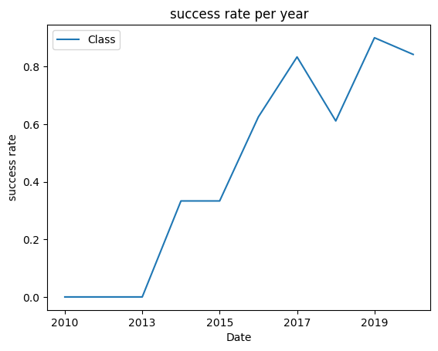
Launch Success Yearly Trend
We can see that the sucess of the missions kept raising with time. We can probably say that the experience with the past missions, knowledge and increase in technology, helped the sucess of the missions.

Slide 24
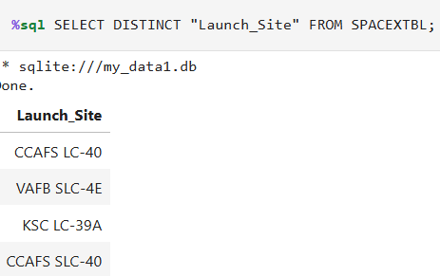
All Launch Site Names
This SQL query retrieves all distinct launch sites from the SpaceX mission dataset. The result shows that launches took place at multiple locations, including CCAFS LC-40, VAFB SLC-4E, KSC LC-39A, and CCAFS SLC-40.

Slide 25
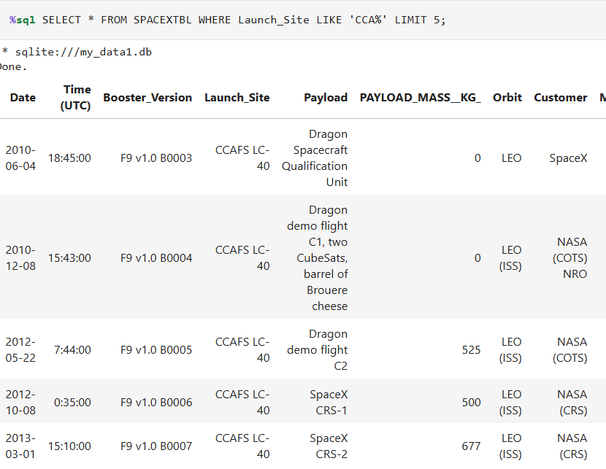
Launch Site Names Begin with 'CCA'
This query displays the first 5 launches where the launch site starts with “CCAFS”. It includes mission details such as date, booster version, payload, orbit, customer, and payload mass. This helps focus the analysis on launches from the Cape Canaveral Air Force Station.

Slide 26
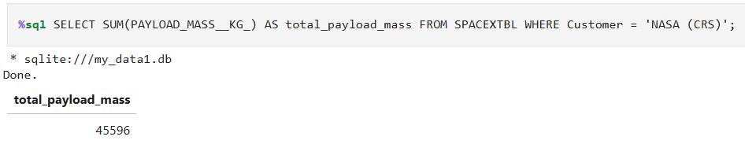
Total Payload Mass
This query calculates the total payload mass delivered by SpaceX for NASA’s Commercial Resupply Services (CRS) missions. The result shows that SpaceX launched a combined payload of 45,596 kg for NASA (CRS).

Slide 27
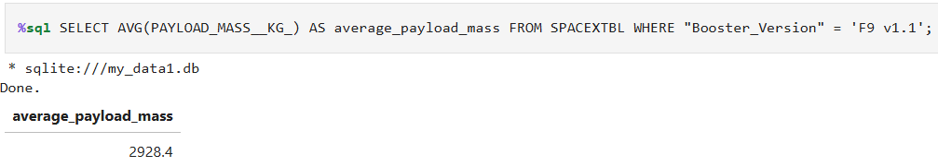
Average Payload Mass by F9 v1.1
This query calculates the average payload mass carried by the F9 v1.1 booster version. The result shows an average of 2,928.4 kg, providing insight into this booster’s typical mission load capacity.

Slide 28
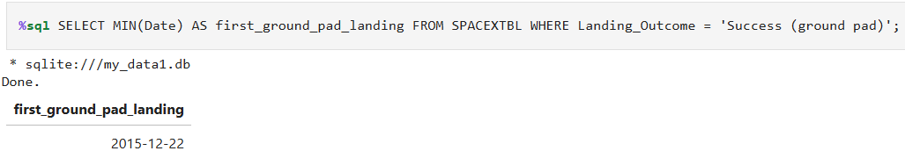
First Successful Ground Landing Date
This query identifies the date of SpaceX’s first successful landing on a ground pad. The result, December 22, 2015, marks a major milestone in reusable rocket technology.

Slide 29
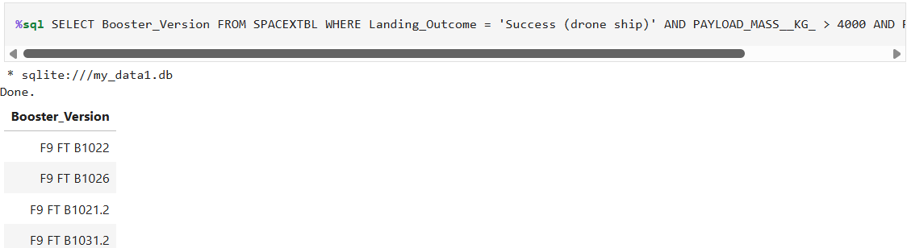
Successful Drone Ship Landing with Payload between 4000 and 6000
This query lists booster versions that successfully landed on a drone ship while carrying payloads between 4000 and 6000 kg. Boosters like F9 FT B1022, B1026, B1021.2, and B1031.2 demonstrated reliable performance under these conditions.

Slide 30
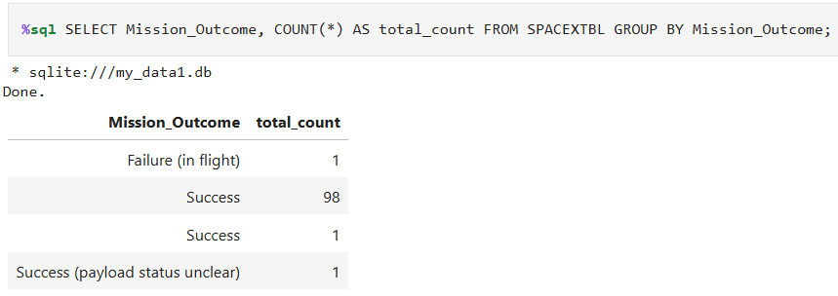
Total Number of Successful and Failure Mission Outcomes
This query groups all missions by outcome and counts how many times each occurred. The vast majority were successful (98 missions), with only a few exceptions, including 1 in-flight failure and 1 mission with unclear payload status.

Slide 31
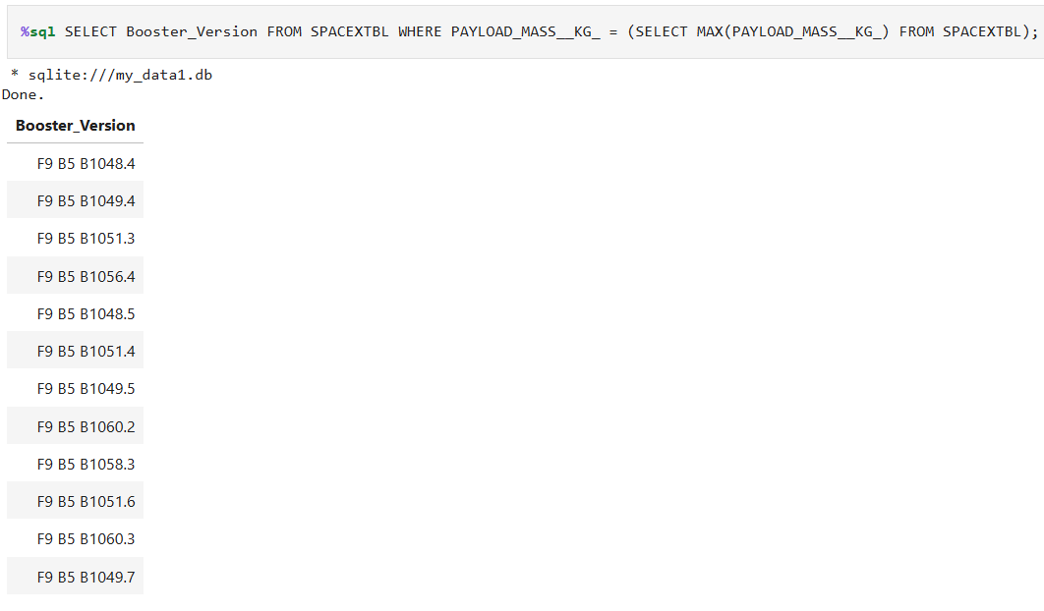
Boosters Carried Maximum Payload
This query identifies all booster versions that carried the heaviest payload recorded in the dataset. Multiple boosters, including versions like F9 B5 B1048.4, B1056.4, and B1060.3, were used for these high-capacity missions.

Slide 32
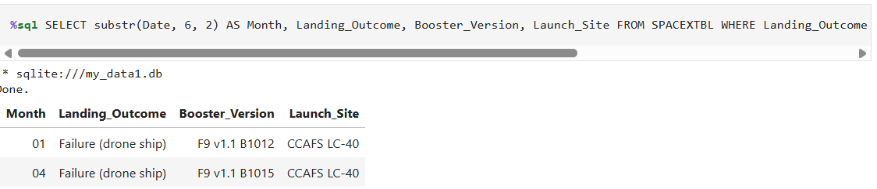
2015 Launch Records
This query extracts missions from 2015 with failed drone ship landings, showing the month, booster version, and launch site. Two failures occurred in January and April, both from CCAFS LC-40 using early F9 v1.1 boosters.

Slide 33
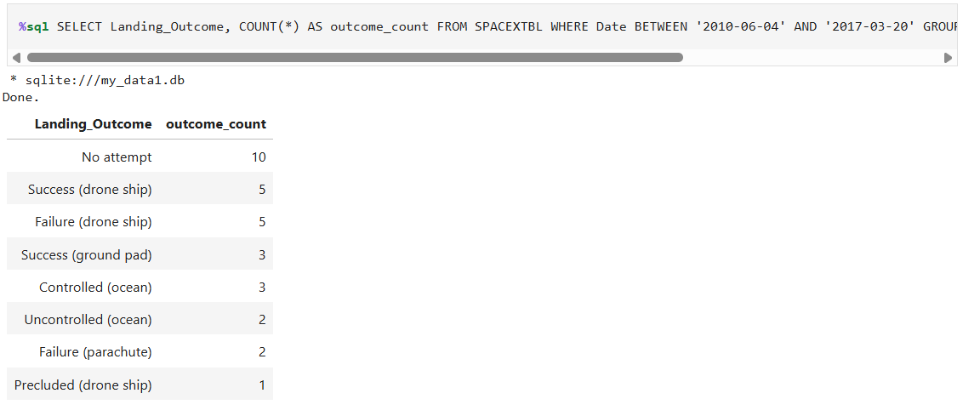
Rank Landing Outcomes Between 2010-06-04 and 2017-03-20
This query ranks the number of landing outcomes between June 2010 and March 2017. The most frequent case was "No attempt" (10 missions), followed by successful and failed drone ship landings (5 each), and ground pad landings (3). The results highlight the evolution of SpaceX's landing capabilities over time.

Slide 34

Section 3

Slide 35
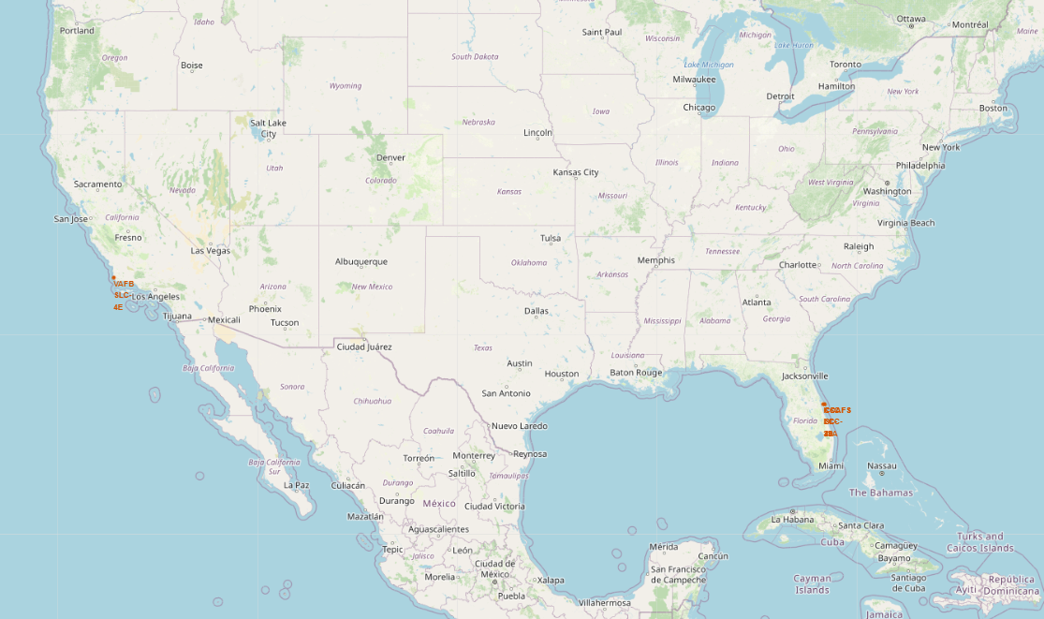
All Launch Sites Map
Launch Sites locations near the coast, in the U.S

Slide 36
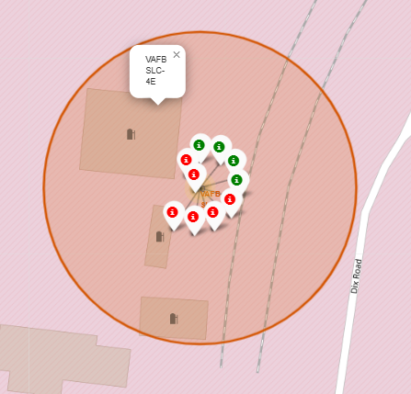
Launch site with success markers
Florida Launch Site Example with outcomes marked in green/red, meaning, sucessful(green) or failure(red)

Slide 37
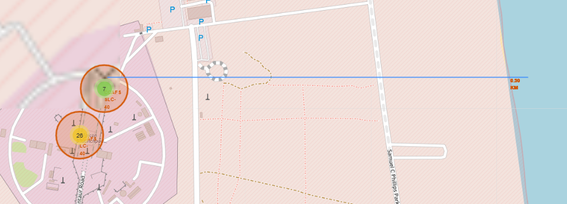
Launch Site Proximities
Example of launch site map, marking the distance to coastline

Slide 38

Section 4

Slide 39
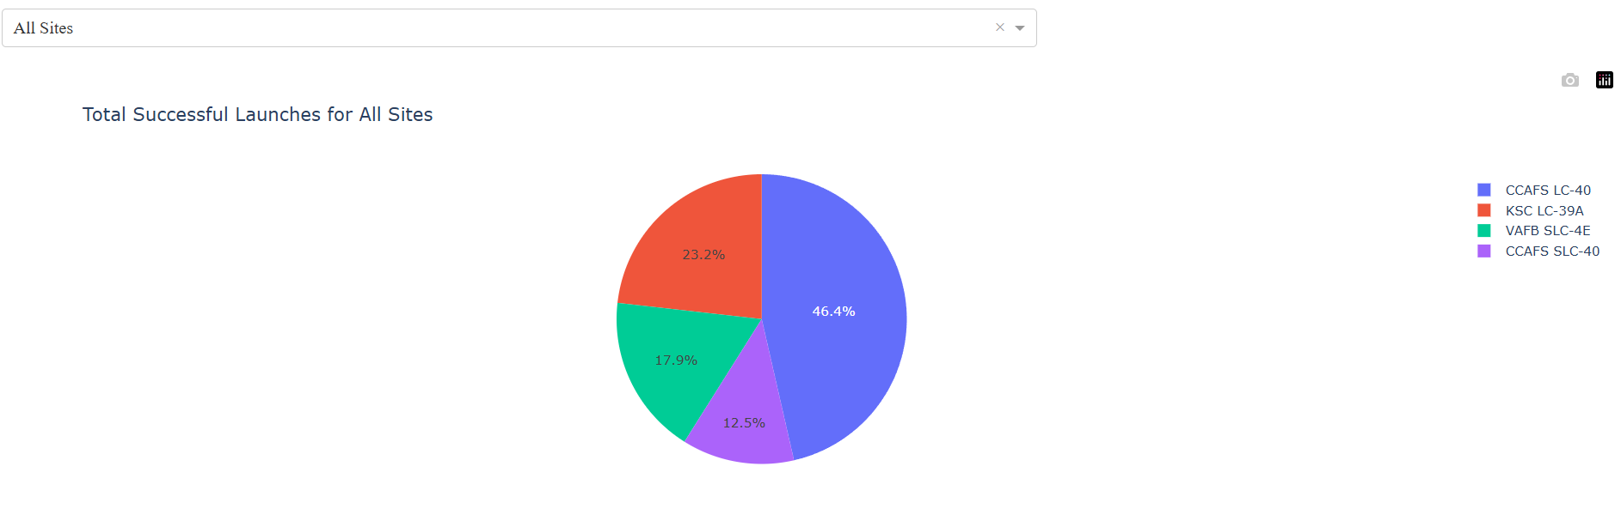
Pie chart- Success rate per Launch Site

Slide 40
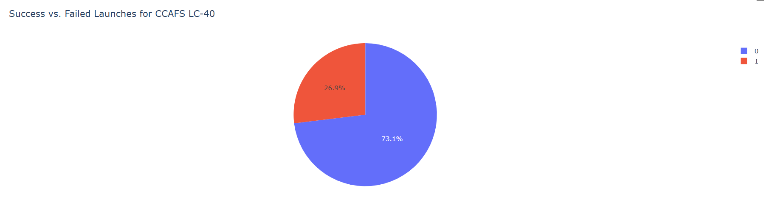
Pie chart – CCAFS LC-40 Success rate

Slide 41
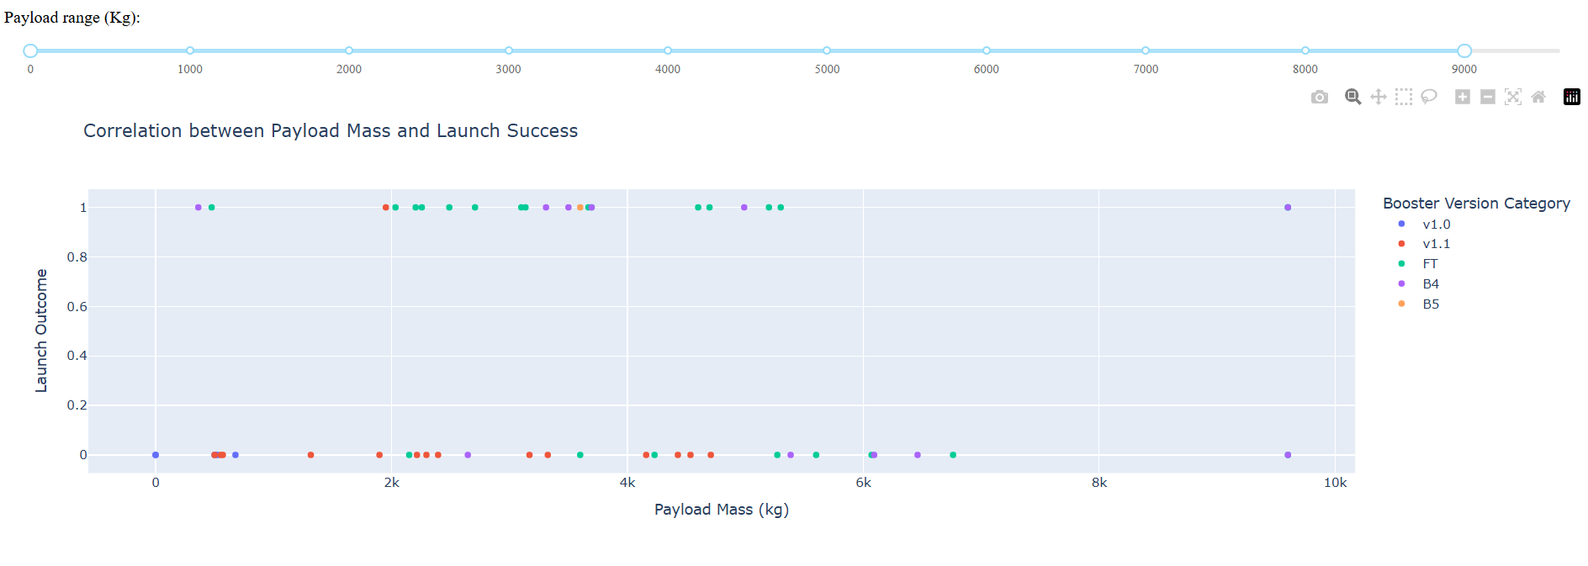
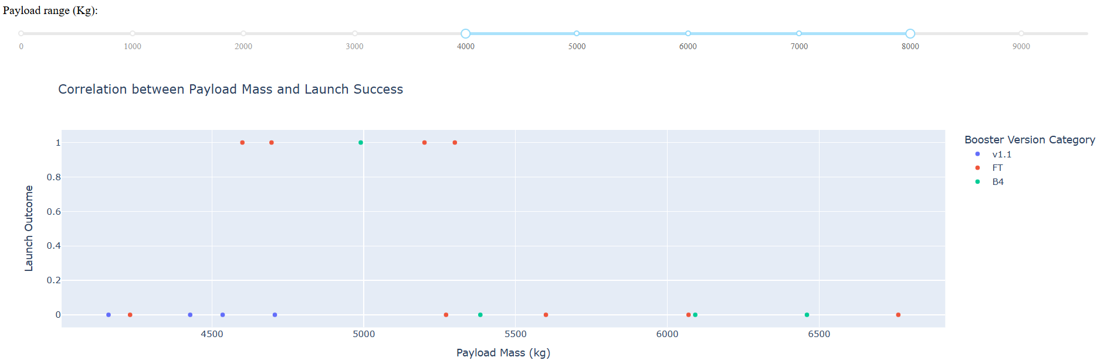
Scatter Plot by Payload Range

Slide 42

Section 5

Slide 43
Classification Accuracy
Best scenario found while traing was the decision tree model with 87,5%

Slide 44
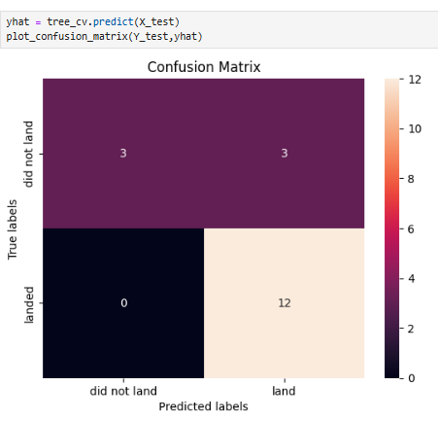
Confusion Matrix
This confusion matrix evaluates the performance of a Decision Tree classifier on the test set. The model correctly predicted 12 successful landings and 3 failures. However, it also misclassified 3 failures as successes, indicating a slight imbalance in distinguishing failed landings. Overall, the model shows strong performance, particularly for identifying successful missions.

Slide 45
Conclusions
In this project, we explored, analyzed, and modeled SpaceX launch data to understand the key factors that influence landing success. Using SQL, we extracted insights related to launch sites, payloads, booster versions, and landing outcomes. We then built and evaluated several classification models to predict landing success.
Among all models tested, the Decision Tree performed best, achieving strong predictive accuracy and clearly identifying successful landings.
Over time, we observed that SpaceX’s success rate has significantly increased, especially from 2013 onward, reflecting their growing experience and technological improvements. This trend highlights how continuous learning and iteration have led to more reliable booster landings.
We also found that missions targeting orbits such as ES-L1, GEO, HEO, and SSO tend to have higher success rates, suggesting that both mission type and orbital destination influence outcomes.
Overall, this project demonstrates how data science can provide valuable insights to improve aerospace operations, reduce costs, and support strategic decision-making.

Slide 46


